Slide 1
FOREGROUND MASKING RESEARCH
Spike Gate Phase 2
Conservative foreground masking with connected-component gate support
SEP audit | MTObjects audit | 182-galaxy diagnostic run
20 August 2026

Slide 2
Why Phase 2 was necessary
02
Objective-only agreement could reward a galaxy-scale mask simply because it overlapped a Spike Gate target.
The consequence
Phase 2 correction
Release gate
High apparent recovery without scientifically safe masking
Recovery credit only for compact, gate-supported connected components
Audit first; run 182 galaxies only when component behaviour is credible

Slide 3
Residual evidence; science-image segmentation
03
1
Residual image
2
Science image
3
Native components
4
Final mask
>
>
>
Spike Gate candidates
SEP or MTObjects
Target + support + size rules
Log-linear profile bridge
Retention rules
Protection terms
Intersects compact target >=20% inside permitted support <=8% of diagnostic view
Excess-area penalty Protected galaxy loss Zero-detection penalty for credible gates

Slide 4
MTObjects outperforms SEP in the stress test
04
11.1%
49.3%
11/15
2/15
SEP mean gate recovery
MTO mean gate recovery
SEP zero detections
MTO zero detections
SEP
MTObjects
Infeasible; earlier apparent recovery was largely driven by galaxy-scale components. Do not proceed.
Narrowly infeasible, but compact component behaviour justified a conservative diagnostic batch.

Slide 5
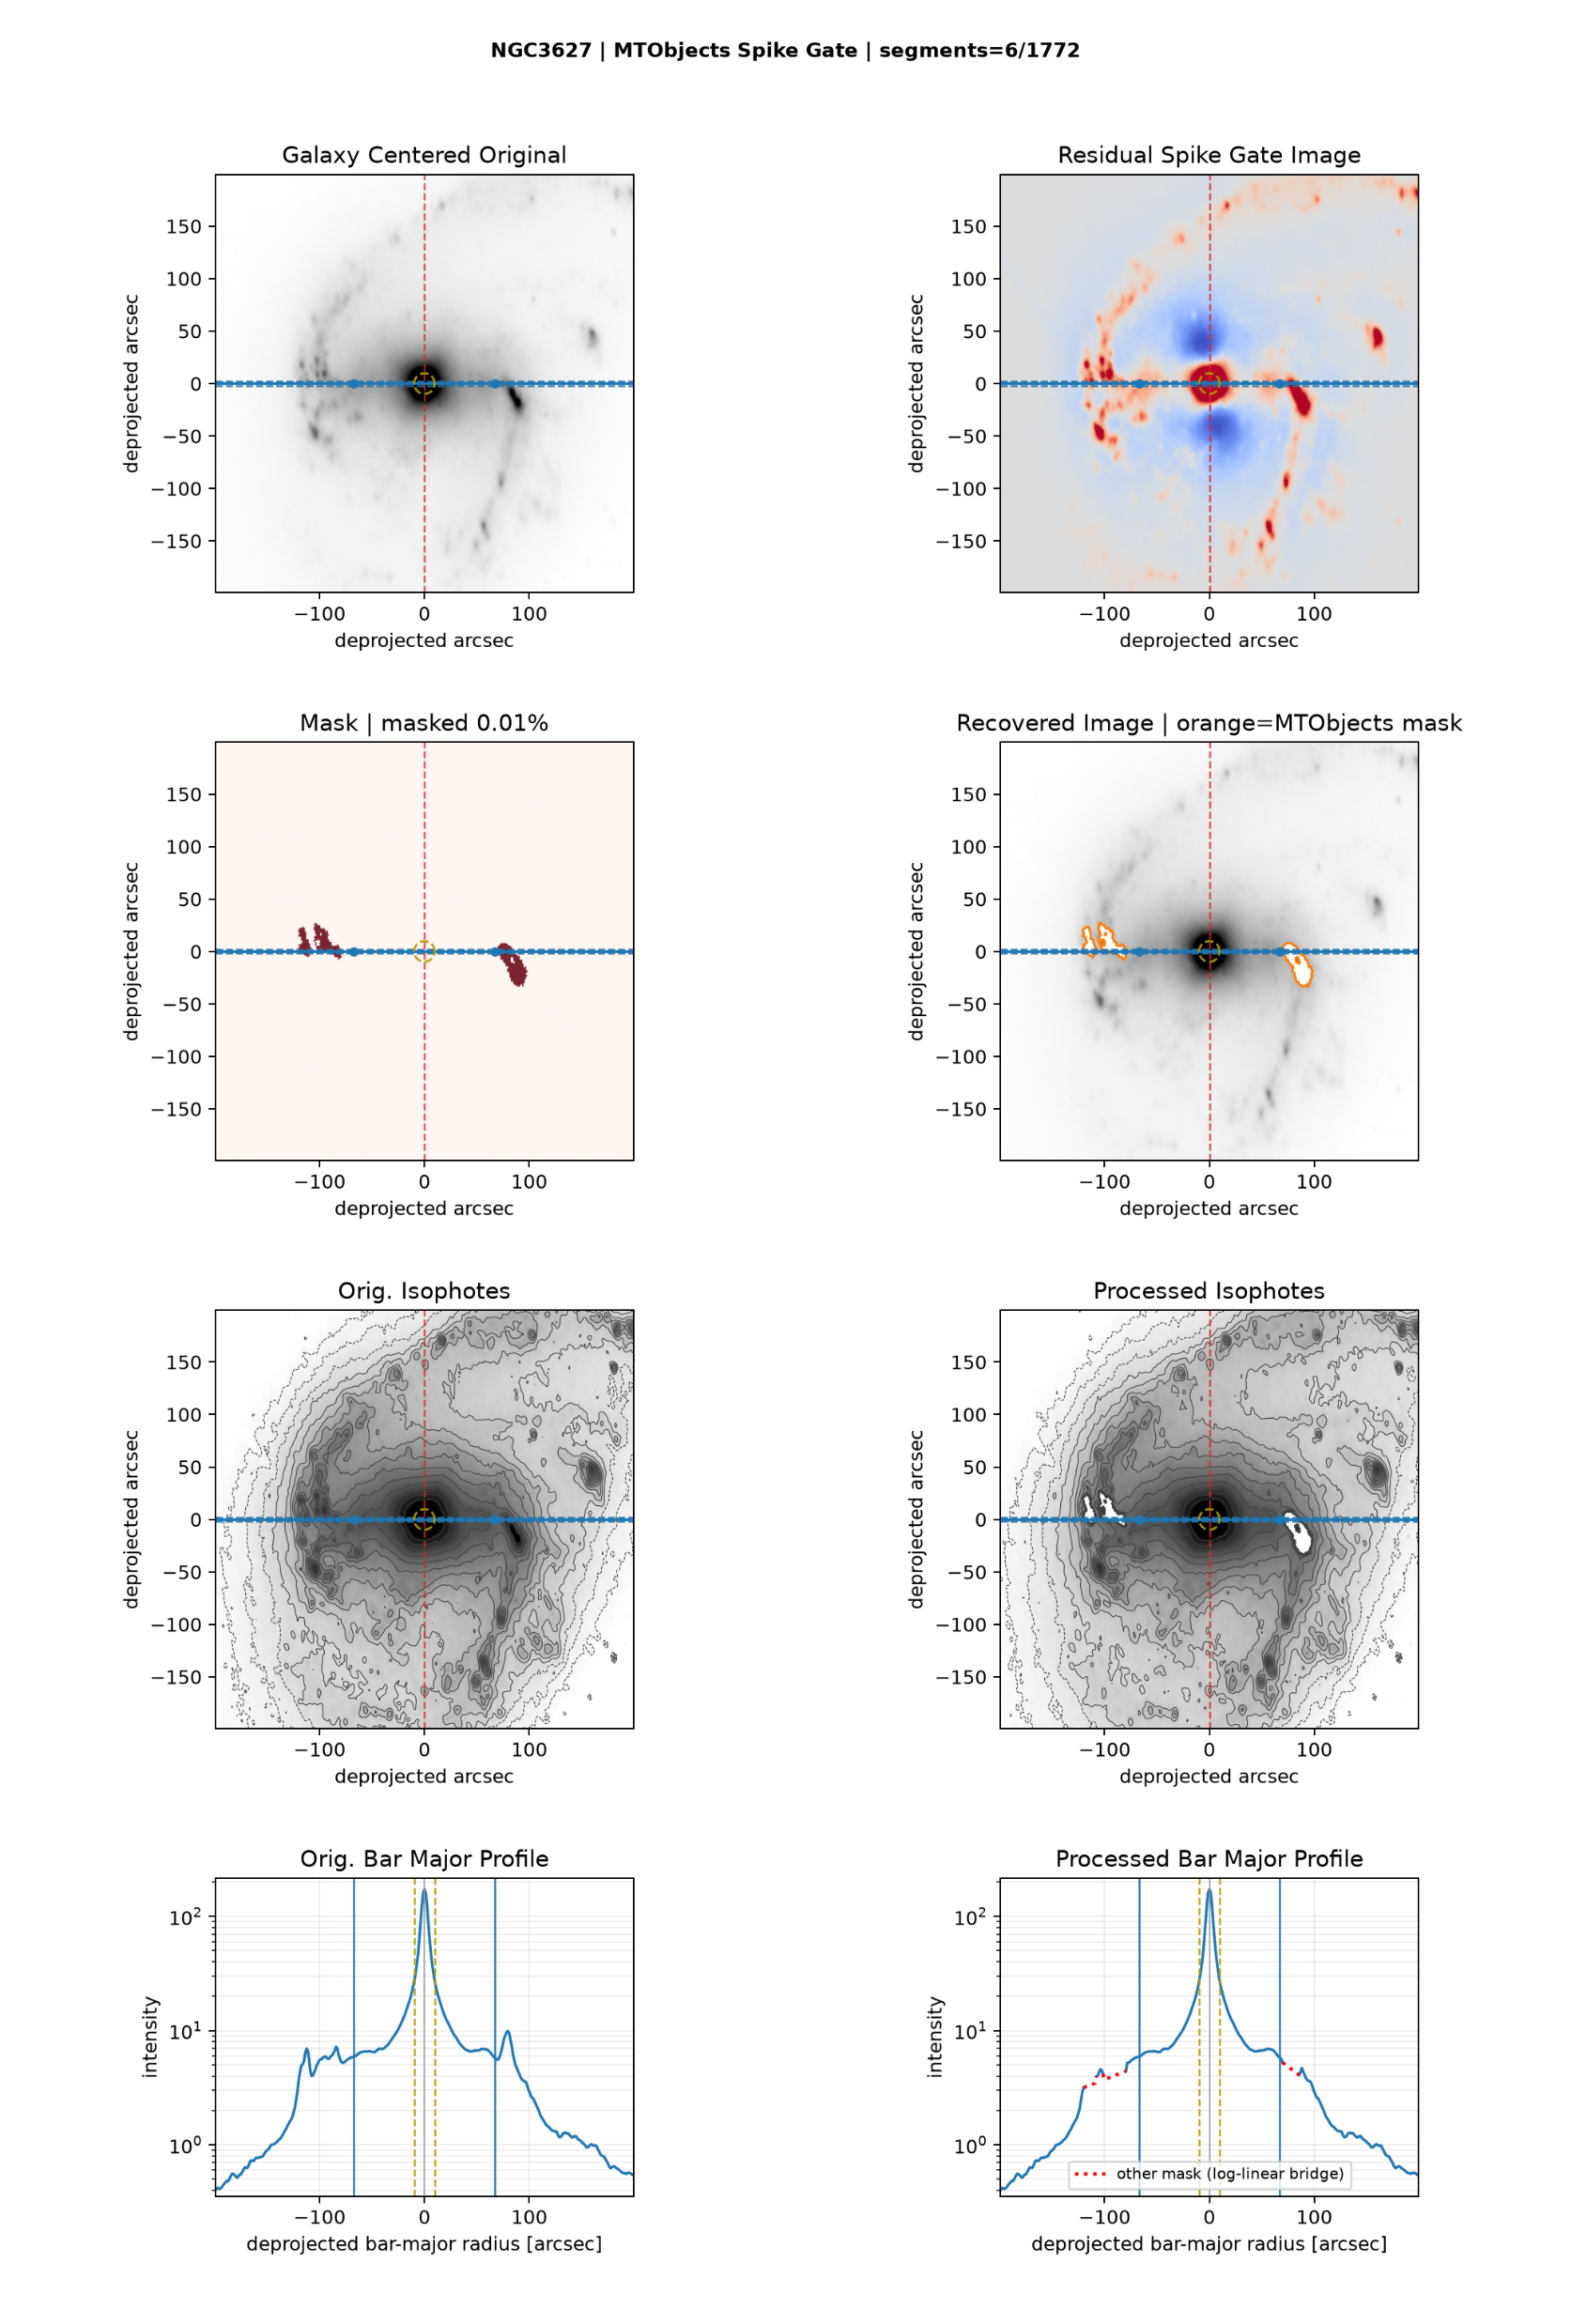
NGC3627: compact masks preserve structure
05
MTO Phase 2
3 gate-supported components 100% gate recovery 100% candidate detection 0.0146% masked area
Spiral structure and isophotal alignment are preserved.

Slide 6
182-galaxy MTO diagnostic run
06
182/182
127
97
55/55
successful; zero failures
gate-positive galaxies
accepted non-zero masks
gate-negative left unmasked
Masked-area distribution
Interpretation
Mean 0.002778% Median 0.000685% 95th percentile 0.013278% Maximum 0.021179% (NGC6412)
Very low mask area confirms conservatism. It does not, by itself, prove correct recovery.

Slide 7
Limitations that still matter
07
30/127
NGC5236
Not a catalogue
gate-positive galaxies had no accepted component
11,537 raw segments 4m17s runtime manual and performance flag
Phase 2 protects bar-profile analysis; it is not yet a complete foreground-object inventory.
Low area is a safety signal. Candidate-level validation is the missing correctness signal.

Slide 8
Improve recall locally, not globally
08
Retain MTO Phase 2 as the conservative diagnostic baseline.
1
Score gate credibility and match candidates explicitly
2
Add native-coordinate accounting and morphology protection
3
Recover only credible misses with a tightly constrained local search
Release target: >=70% credible-candidate recovery, >=75% detection, no coherent galaxy-structure loss.

